Slide 1
IBM CAPSTONE PROJECT:
The Battle of Neighborhoods Jose Vicente González Faus

Slide 2
Capstone Project - REPORT CONTENT
1.Introduction Section : Discussion of the business problem and the interested audience in this project.
2.Data Section : Description of the data that will be used to solve the problem and the sources.
3.Methodology section : Discussion and description of exploratory data analysis carried out, any inferential statistical testing performed, and if any machine learnings were used establishing the strategy and purposes.
4.Results section : Discussion of the results.
5.Discussion section : Elaboration and discussion on any observations noted and any recommendations suggested based on the results.
6.Conclusion section : Report Conclusion.

Slide 3
Introduction:
New York City (NYC), often called simply New York, is the most populous city in the United States. With an estimated 2019 population of 8,336,817 distributed over about 302.6 square miles (784 km2), New York City is also the most densely populated major city in the United States. New York City is composed of five boroughs, each of which is a county of the State of New York. The five boroughs—Brooklyn, Queens, Manhattan, the Bronx, and Staten Island—were consolidated into a single city in 1898.
This final project explores the best locations for Sushi restaurants throughout the city of New York. As New York is the most diverse city in the world (800 languages are spoken in New York), it has a long tradition of different ethnical restaurants. Now when the idea of a healthy lifestyle conquered the minds of people all over the country, Sushi restaurants became extremely popular, as they offer a healthy alternative to regular American eating habits. That's why potentially the owner of the new Japanese restaurant can have great success and consistent profit. However, as with any business, opening a new restaurant requires serious considerations and is more complicated than it seems from the first glance. In particular, the location of the restaurant is one of the most important factors that will affect whether it will have success or a failure. So my project will attempt to answer the questions “Where should the investor open a Sushi Restaurant in Manhattan?” and “Where should I go If I want great Shusi?”

Slide 4
Data Section:
In order to answer the above questions, data on New York City neighborhoods, boroughs to include boundaries, latitude, longitude, restaurants, and restaurant ratings and tips are required.
1. New York City data containing the neighborhoods and boroughs, latitudes, and longitudes will be obtained from the data source: https://cocl.us/new_york_dataset
2.All data related to locations and quality of Sushi restaurants will be obtained via the FourSquare API utilized via the Request library in Python.

Slide 5
Methodology:
-We will Collect the New York city data from https://cocl.us/new_york_dataset.
-Using FourSquare API we will find all venues for each neighborhood.
-Well will filter out all Sushi restaurants.
-Using common venue for each Sushi restaurant , we will sort that data.
-Visualize the Ranking of neighborhoods using folium library(python).

Slide 6
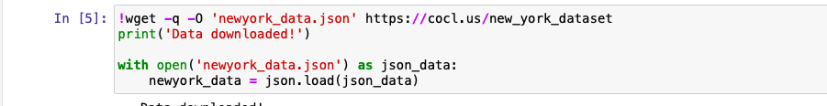
Download and explore data set

Slide 7
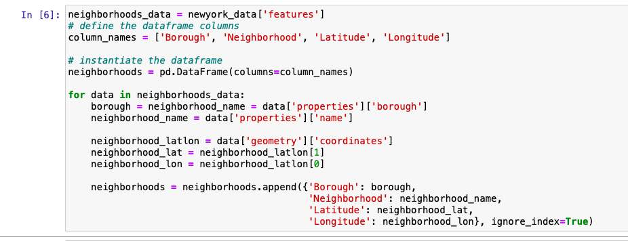
We will prepare the data getting the borough, neighborhood with the latitude and longitude. To do it we transform the data into a dataframe and apply the following code:

Slide 8
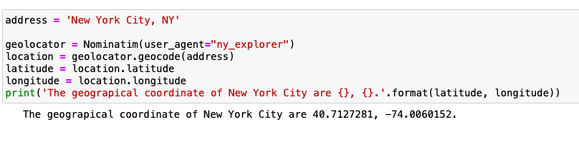
Later use geopy library to get the latitude and longitude values of New York City. In order to define an instance of the geocoder, we need to define a user_agent. We will name our agent ny_explorer, as shown below.

Slide 9
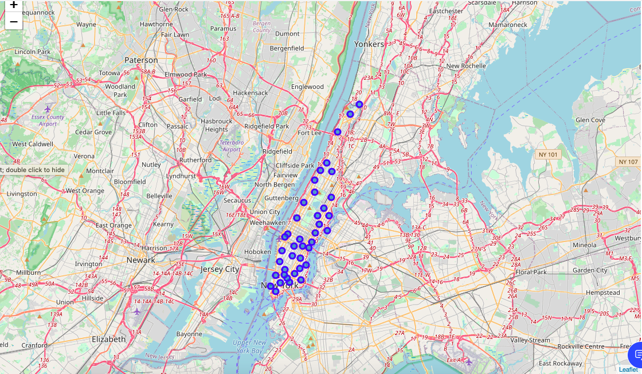
Once we have the latitude and longitude of New York. We will create a map of the city with each neighborhoods of the borough of Manhattan superimposed on it.

Slide 10
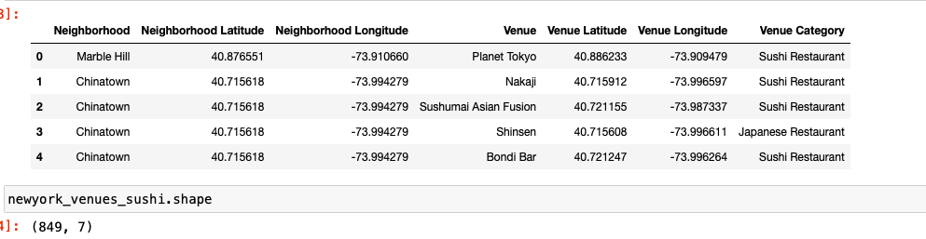
Using Foursquare API Location Data:
The Foursquare API retrieve information about the Venue, Venue category with there longitudes and latitudes. Our venue category are Sushi restaurant in every neighborhood of Manhattan.
The call that we do with our credentials (client ID and client secret) returns a JSON file and we need to turn that into a dataframe.

Slide 11
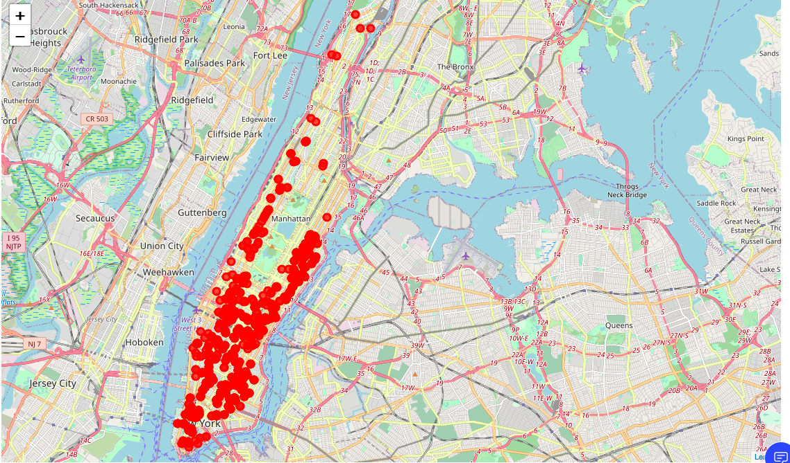
After we have the dataframe we visualize it in a map of New York City.

Slide 12
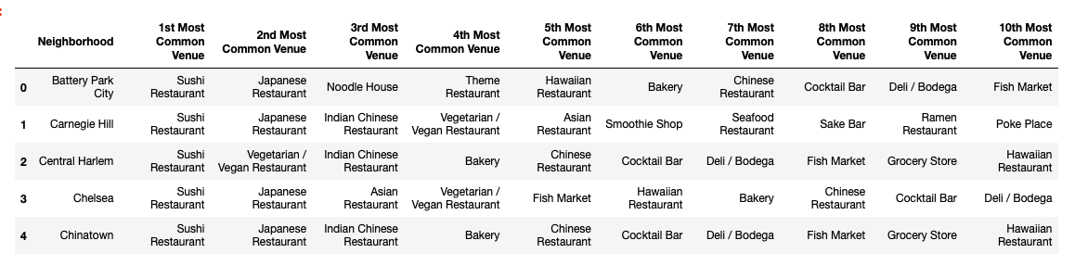
Analyze each neighborhood:
We create a dataframe to analyze in each neighborhood the most common venue. As we can see, it’s very popular the Sushi Venues.

Slide 13
Cluster Neighborhoods:
After we have the most common venue in each neighborhood, we use a Machine Learning to group the neighborhoods in clusters, to see which cluster or area is most important. To cluster the neighborhood we have to check in with cluster we have more sushi restaurant. To do it we create the next dataframe.

Slide 14
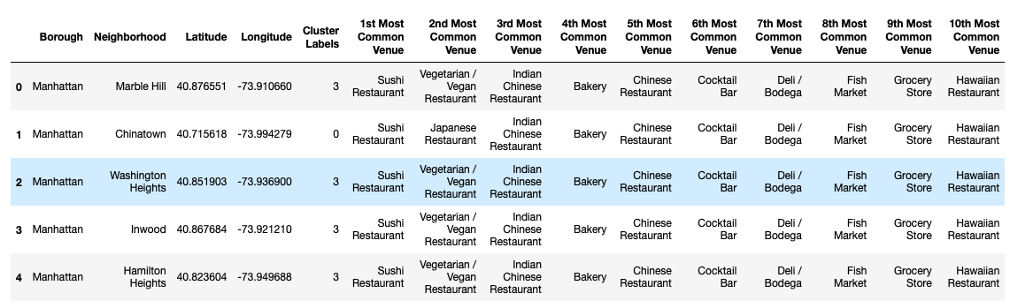

Slide 15
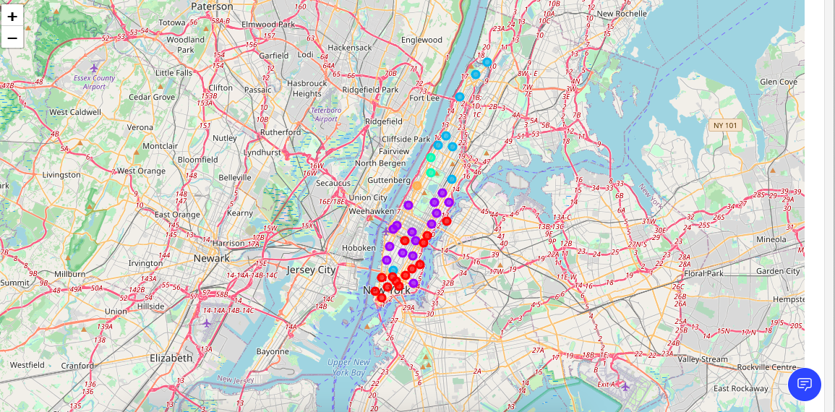
In our case we are going to use 5 cluster. Bellow we can visualize the map of NY with 5 cluster around of the borough of Manhattan. Every cluster is a group of Sushi venues.

Slide 16
Results:
The results of the exploratory data analysis and clustering is summarized below :
-Analyzing the data we can affirm that sushi restaurant es a very common venue in Manhattan.
-After clustering the neighborhoods of the borough we stablish that cluster 1 (colour purple in the map) has the more quantity of sushi restaurants.
-Cluster 0 (colour red in the map) is the second cluster with more sushi restaurants.
-Otherwise cluster 2 (colour orange in the map) and cluster 4 (colour green in the map) have the least number of sushi restaurants.

Slide 17
Discussion:
-After analyze the results we check that from Central Park to Manhattan Bridge (South Side Manhattan) is a touristic and financial area, that is the reason because we can find more Sushi restaurant in this area. This area is the most important zone of Manhattan. This area includes cluster purple and red, just the two clusters with more number of Sushi restaurant.
-The rest of area of Manhattan from the Central Park to Inwood Hill Park (The north side Manhattan) is a residential area. There are not as many business as in the south touristic zone.
-Based on the result of the project an investor should open a sushi restaurant in the area of the cluster purple or in case that can not afford it would also be interesting open it in the red cluster. Basically is all the touristic and financial area where greater consumption is generated.

Slide 18
Conclusion:
Finally, to conclude this project, we have got a small glimpse for how real-life Data science project looks like. I have used some frequently used python libraries to handle JSON file, plotting maps, and other exploratory data analysis. Use Foursquare API to major boroughs of New York City and their neighborhoods. Potential for this kind of analysis in a real-life business problem is discussed in great detail. As a final note, all of the above analyses is depended on the adequacy and accuracy of Four Square data.

